Slide 1
Technology and customer service
Module/ Unit 6

Slide 2
Use of technology in travel Agency
#1 Internet and its usage
The widespread public use of the world wide web has created a number of conditions that have been kind of game-changers, bringing agencies both huge benefits as well as some detrimental ways.
One way or the other, by the end of the day, Internet is helping to create the modern travel agency.
So, travel agencies have to make considerable adaptations to remain in business and alive!

Slide 3
#2 Book it yourself
The self-service idea has arrived to tourism as well, assuring that booking a hotel, a plane ticket or a week's vacation is now much easier.
In fact, customers looking for booking a trip no longer have to physically visit an agency, all they need to do is go online, look for companies that offer that kind of services and book an entire trip themselves.
The same is valid for airlines and hotels where customers are now allowed to book tickets and lodging directly from these companies' websites.
That is a reality travel agencies have to learn how to deal with, reinventing themselves and offering differential services that are able to put them again on the route of the customer needs.

Slide 4
#3 Relationship with clients
One of the ways of doing it may well be by creating a new kind of relationship between travel agencies and clients.
By using platforms like the Internet and social media and taking advantage of better communications, travel agencies have widened the ways in which they can communicate not only with customers, but also with their business network and partner services.
This way, data is available in a few seconds and visible by everyone, transforming a process that once might have taken hours, into an instantly thing, boosting productivity and reducing dead times.
By the end of the day, travel agencies have happier clients.

Slide 5
4 Start to build a social media presence
Social media is far from fading away. So, travel agents and agencies need to "get a personality" in this new world.
To put it differently, it is important to start building a social media presence and incorporate social media into marketing and communications strategies as soon as possible.
Social media is one of the more significant tools nowadays. Major businesses are already employing it to build brand awareness and customer relationships with some very good results.

Slide 6
5 Mobile is king!
The portability and the increasing facility with which customers are now able to search, compare and book trips on the go, is causing a tremendous change in the way travellers interact with the tourism industry and travel agencies, themselves.
More than this, the problem is that mobility is driving a demand for a 24/7 booking service and customers accept no less than that. Once again, travel agencies have to adapt to this swift change of reality.

Slide 7
# 6 Digitization
"Digitization in aviation, travel, and tourism is expected to increase profitability throughout the ecosystem, creating up to 305 billion dollars (270 billion euros) in value over the decade spanning 2016 to 2025", according to Accenture and the World Economic Forum report.
Digitization has long been an excellent way for promoting efficiencies and boosting operational performance.
This is a reality that travel industry players are now being aware of, leveraging these emerging technologies to transform the customer experience.

Slide 8
# 7. Big data, robotics, virtual and artificial Intelligence
That happens in each and every industry and tourism is no stranger to this reality: the huge amount of customer data at the disposal of travel agencies is allowing for a more pervasive analysis and efficient predictions based on behavioural information.
On the other hand, intelligent virtual assistants are increasingly being integrated into mobile devices and messaging apps, assuring travel agencies can offer a truly on-demand service which makes clients happier.
Robotics are also a thing to have in mind, as they might have a big part to play when it comes to disruption in the travel industry over the coming years.
Virtual reality is allowing agencies to "transport" customers to their dreamed destinations, where they can take guided tours of hotels located thousands and thousands of miles away.

Slide 9
Reservation systems
GDS
GDS is an online system known as global distribution system, which has been bridging the gap worldwide between tour operators and travel bookers by providing centralized services by covering the bookings of airlines tickets, car rental, hotel rooms and more.
It delivers world wide data, rates, inventory, offers, real-time availability of airlines, hotel rooms, car rental, bus tickets and many more to make the travel industry more informatics and sophisticated.

Slide 10
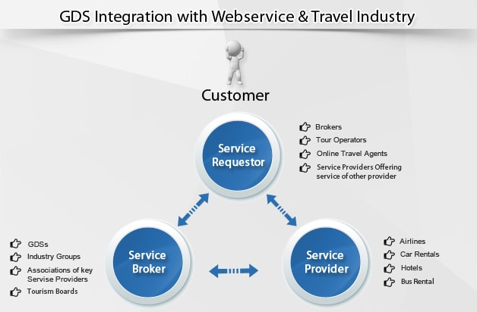

Slide 11

Popular GDS Systems in Travel Industry

Slide 12
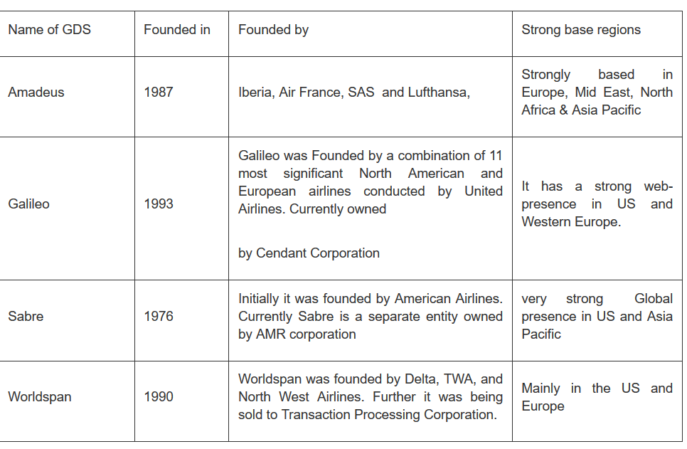

Slide 13
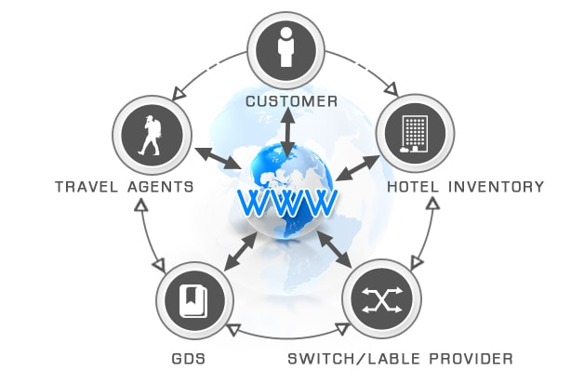
Why use GDS?
GDS is a computerized web service that provides pricing, real time availability, centralized data display with reservation functionality to the global travel industry in a very unified process.

Slide 14
Benefits of Global distribution systems:
Highly effective in alluring the international travelers.
improved the travel shopping experience and convenience for consumers and have increased pricing transparency.
enable the retail travel agency and OTA business models.
enable the travel agents to make their travel services available to consumers globally where they might not otherwise be able to achieve efficient worldwide market penetration through direct marketing efforts.
Can get global platform for their business with strong market penetration

Slide 15
Definition
Customer relationship management (CRM) refers to the principles, practices and guidelines that an organization follows when interacting with its customers.
From the organization's point of view, this entire relationship encompasses direct interactions with customers, such as sales and service-related processes, and forecasting and analysis of customer trends and behaviors.

Slide 16
Types- CRM technology
CRM Software
Special CRM software aggregates customer information in one place to give businesses easy access to data, such as contact data, purchase history and any previous contact with customer service representatives.
This data helps employees interact with clients, anticipate customer needs, recognize customer updates and track performance goals when it comes to sales.

Slide 17
CRM software's main purpose is to make interactions more efficient and productive. Automated procedures within a CRM module include sending sales team marketing materials based on a customer's selection of a product or service.
Programs also assess a customer's needs to reduce the time it takes to fulfill a request.

Slide 18
CRM Cloud Solutions
Cloud-based systems provide real-time data to sales agents at the office and in the field as long as a computer, smartphone, laptop or tablet connects to the internet.
Such systems boast heightened accessibility to customer information and eliminate the sometimes-complicated installation process involved with other CRM products or software.

Slide 19
CRM Human Management and Artificial Intelligence
All of the computer software in the world to help with CRM means nothing without proper management and decision-making from humans. Plus, the best programs organize data in a way that humans can interpret readily and use to their advantage

Slide 20
Benefits
MAKE IMPROVEMENTS TO YOUR BOTTOM LINE.
Introducing a CRM platform has been shown to produce real results – including direct improvements to the bottom line
2. IDENTIFY AND CATEGORIZE LEADS.
A CRM system can help you identify and add new leads easily and quickly, and categorize them accurately. By focusing on the right leads, sales can prioritize the opportunities that will close deals, and marketing can identify leads that need more nurturing and prime them to become quality leads.

Slide 21
3. INCREASE REFERRALS FROM EXISTING CUSTOMERS.
By understanding your customers better, cross-selling and upselling opportunities become clear — giving you the chance to win new business from existing customers.
4. OFFER BETTER CUSTOMER SUPPORT.
A CRM system can help you provide the high-quality service that customers are looking for. Your agents can quickly see what products customers have ordered, and they can get a record of every interaction so they can give customers the answers they need, fast.

Slide 22
5. IMPROVE PRODUCTS AND SERVICES.
A good CRM system will gather information from a huge variety of sources across your business and beyond. This gives you unprecedented insights into how your customers feel and what they are saying about your organization — so you can improve what you offer, spot problems early, and identify gaps.

Slide 23
Customer service
Customer service is the act of taking care of the customer's needs by providing and delivering professional, helpful, high quality service and assistance before, during, and after the customer's requirements are met.

Slide 24
Characteristics of Good Customer Service
Promptness: Promises for delivery of products must be on time. Delays and cancellations of products should be avoided.
Politeness: Politeness is almost a lost art. Saying 'hello,' 'good afternoon,' 'sir,' and 'thank you very much' are a part of good customer service. For any business, using good manners is appropriate whether the customer makes a purchase or not.
Professionalism: All customers should be treated professionally, which means the use of competence or skill expected of the professional. Professionalism shows the customer they're cared for.
Personalization: Using the customer's name is very effective in producing loyalty. Customers like the idea that whom they do business with knows them on a personal level.

Slide 25
Customer service issues
Lack of empathy.
If you work with clients or customers in any role, you need to care about the problems they want solved. Show it by taking positive action to help them out.
Poor or missing processes and policies.
Sometimes, you may not have any process or policy in place to help the inside sales customer service representative resolve the customer issue promptly and easily

Slide 26
Too much automation.
There are times when automation can drive buyers crazy. Extreme frustration results when an automated system can’t respond to the buyer’s needs.
Poor or no communication.
There are two key parts to good communication. These are speaking and listening. The importance of listening is too often overlooked.
Poor or no follow through.
“I’ll call you tomorrow to see if (whatever the representative promised) was completed.” Customers hear this, and too often the call does not come as promised. Nothing is more infuriating than lack of follow-up when someone is trying to have an issue resolved.

Slide 27
Growing too fast. When company experiences fast growth, revenue is often re-invested in income-producing activities like sales. In some cases, customer service is seen as an expense rather than a place to invest to retain customers.
Unskilled personnel.
Employees need training, coaching and mentoring. This was never more important than it is now.
Lack of accountability.
Many times when you need a resolve an issue you pray that one individual will take ownership and accountability for your concern.

Slide 28
Customer service process (Handling Client Complaints
Assign & Verify – the first thing your customer service process should do, at this point, is to assign the case to the appropriate customer service representative.
Identify Solution – next, your customer service representative will then need to find the appropriate solution. In an ideal setup the customer service representative would have the ability to search a database of possible solutions.

Slide 29
Deliver Solution – once identified, your customer service representative will need to somehow deliver the solution.
Rework the Case – if the solution fails, the case is automatically rerouted back to the “Identify Solution” stage.
Escalate & Reassign Case – if the case hits a certain threshold, it should then be escalated to the next level and reassigned to the appropriate customer service representative.

Slide 30
Close the Case – once the case has been resolved, the data collected should be used to help improve the customer service process.

Slide 31
Customer service process (Handling Client Complaints
Assign & Verify – the first thing your customer service process should do, at this point, is to assign the case to the appropriate customer service representative.
Identify Solution – next, your customer service representative will then need to find the appropriate solution. In an ideal setup the customer service representative would have the ability to search a database of possible solutions.

Slide 32
Deliver Solution – once identified, your customer service representative will need to somehow deliver the solution.
Rework the Case – if the solution fails, the case is automatically rerouted back to the “Identify Solution” stage.
Escalate & Reassign Case – if the case hits a certain threshold, it should then be escalated to the next level and reassigned to the appropriate customer service representative.

Slide 33
Close the Case – once the case has been resolved, the data collected should be used to help improve the customer service process.

Slide 34
Customer service: Some Related concepts
Quality of Customer Service
Quality customer service is an experience of feeling valued or heard.
It involves examining all encounters and points of interaction with guests to identify points of improvement.
In tourism and hospitality Total Quality Management is a process where service expectations are created by the entire team, with a collaborative approach between management and employees (Kapiki, 2012).

Slide 35
Customer Orientation
It is the set of activities, behaviours, and beliefs that place high priority on customers’ interests and continuously create superior customer value”
While specific customer service jobs require different skills, building an overall customer-oriented organization may better meet customer expectations.

Slide 36
Recovery from Service Failures
Service recovery occurs when a customer service professional takes action that results in the customer being satisfied after a service failure has occurred.

Slide 37
Travel Agent: Starting Your Business
Step 1: Create a plan for your travel business
Step 2: Conduct market research and find your niche
Step 3: Develop a brand as a travel agent
Step 4: Deal with the legal side

Slide 38
Step 5: Determine your funding strategy
Step 6: Choose a location and hire employees
Step 7: Market and launch your travel business

Slide 39
Success Story: Make My Trip
https://www.youtube.com/watch?v=JbHd6CNlyII

Slide 40
In Room Terminal-Consumer service
In general In-Room terminal acts as a integrated operating element for hospitality service, such as presence buttons, call and doctor call button. High-quality LCD with additional multifunction buttons.
In terms of travel agency in-room terminal is quantified to one stop service for all products and ancillary services to the consumers where consumers can have and connect to each service prospects by checking into the travel agency portal or service terminal.
For example consumer can access the service for entertainment by clicking the portal which acts as integrated source for them

Slide 41
Important elements:
Travel agencies while preparing for In room terminals need to look for
Civic /sense of Hospitality
Streamlining of consumer processing
Personalization methods/options
Availability of Choices
Customer value
Ease of Access

Slide 42
Importance
Flexibility: Helps in minimizing the expenditure and allow the space for additional and future services
Sustainability: It enhances the customer services and experiences and increase the loyalty amongst them
Large Connectivity: Provide space to large number of consumers and get connected to various service providers at a time

Slide 43
Streamlined processing: within the less time consumers get explore as many services and products thereby helps not only in generating consumer satisfaction but also streamlines revenue generation process

